Slide 1
Debugging an application
Chapter -

Slide 2
What is debugging
Without fail, the code we write as software developers doesn’t always do what we expected it to do. Sometimes it does something completely different! When this happens, the next task is to figure out why, and although we might be tempted to just keep staring at our code for hours, it’s much easier and efficient to use a debugging tool, or debugger.
A debugger, unfortunately, isn’t something that can magically reveal all the problems or “bugs” in our code. Debugging means to run your code step by step in a debugging tool like Visual Studio, to find the exact point where you made a programming mistake. You then understand what corrections you need to make in your code, and debugging tools often allow you to make temporary changes so you can continue running the program.
Using a debugger effectively is also a skill that takes time and practice to learn but is ultimately a fundamental task for every software developer.

Slide 3
Debugging mode
Step through your code in debugging mode to find where the problem occurred
When you normally run an app, you see errors and incorrect results only after the code has run. A program might also terminate unexpectedly without telling you why.
Running an app within a debugger, also called debugging mode, means that the debugger actively monitors everything that’s happening as the program runs. It also allows you to pause the app at any point to examine its state, and to then step through your code line by line to watch every detail as it happens.

Slide 4
Debugging mode
In Visual Studio, you enter debugging mode by using F5 (or the Debug > Start Debugging menu command or the Start Debugging button Start Debugging in the Debug Toolbar).
If any exceptions occur, Visual Studio’s Exception Helper takes you to the exact point where the exception occurred and provides other helpful information.

Slide 5
breakpoints
If you didn't get an exception, you probably have a good idea where to look for the problem in your code. This is where you use breakpoints with the debugger to give yourself a chance to examine your code more carefully. Breakpoints are the most basic and essential feature of reliable debugging. A breakpoint indicates where Visual Studio should pause your running code so you can take a look at the values of variables, or the behavior of memory, or the sequence in which code runs.
In Visual Studio, you can quickly set a breakpoint by clicking in the left margin next to a line of code. Or place the cursor on a line and press F9.

Slide 6
https://docs.microsoft.com/en-us/visualstudio/debugger/debugging-absolute-beginners?view=vs-2017

Slide 7
Navigate code in the debugger using step commands
To start your app with the debugger attached, press F11 (Debug > Step Into). F11 is the Step Into command and advances the app execution one statement at a time. When you start the app with F11, the debugger breaks on the first statement that gets executed.
The yellow arrow represents the statement on which the debugger paused, which also suspends app execution at the same point (this statement has not yet executed).
F11 is a good way to examine the execution flow in the most detail.

Slide 8
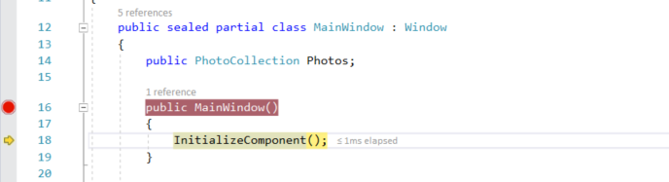

Slide 9
Step over code to skip functions
When you are on a line of code that is a function or method call, you can press F10 (Debug > Step Over) instead of F11.
F10 advances the debugger without stepping into functions or methods in your app code (the code still executes). By pressing F10, you can skip over code that you're not interested in. This way, you can quickly get to code that you are more interested in.

Slide 10
Step into a property
As mentioned earlier, by default the debugger skips over managed properties and fields, but the Step Into Specific command allows you to override this behavior.
Right-click on a property or field and choose Step Into Specific, then choose one of the available options.

Slide 11
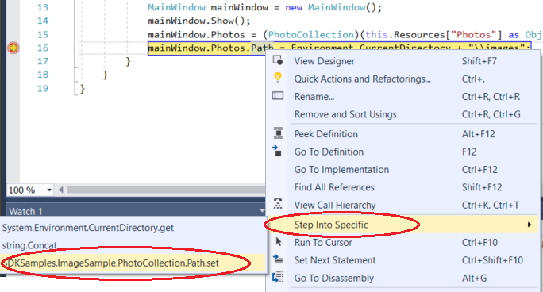
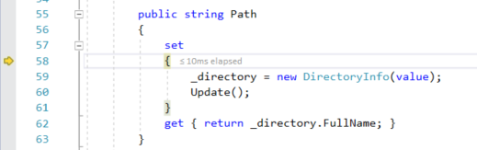
In this example, Step Into Specific gets us to the code for Path.set.

Slide 12
Run to Click
The Run to Click (Run execution to here) button is new in Visual Studio 2017.
Click the Run to Click (Run execution to here) button. The debugger advances to the line of code where you clicked.
Using this button is similar to setting a temporary breakpoint. This command is also handy for getting around quickly within a visible region of app code. You can use Run to Click in any open file.

Slide 13
Advance the debugger out of the current function
Advance the debugger out of the current function
Sometimes, you might want to continue your debugging session but advance the debugger all the way through the current function.
Press Shift + F11 (or Debug > Step Out).
This command resumes app execution (and advances the debugger) until the current function returns.

Slide 14
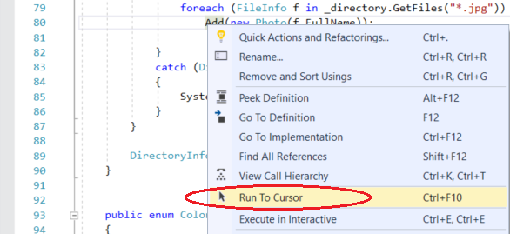
Run to cursor
Stop the debugger by pressing the Stop Debugging red button Stop Debugging or Shift + F5.
Right-click a line of code in your app and choose Run to Cursor. This command starts debugging and sets a temporary breakpoint on the current line of code
If you have set breakpoints, the debugger pauses on the first breakpoint that it hits.
Press F5 until you reach the line of code where you selected Run to Cursor.
This command is useful when you are editing code and want to quickly set a temporary breakpoint and start the debugger at the same time.
Notes:
https://docs.microsoft.com/en-us/visualstudio/debugger/debugger-feature-tour?view=vs-2017

Slide 15
Restart your app quickly
Click the Restart App button in the Debug Toolbar (Ctrl + Shift +F5).
When you press Restart, it saves time versus stopping the app and restarting the debugger. The debugger pauses at the first breakpoint that is hit by executing code.
If you do want to stop the debugger and get back into the code editor, you can press the red stop Stop Debugging button instead of Restart.

Slide 16
Inspect variables with data tips
Now that you know your way around a little, you have a good opportunity to start inspecting your app state (variables) with the debugger. Features that allow you to inspect variables are some of the most useful features of the debugger, and there are different ways to do it. Often, when you try to debug an issue, you are attempting to find out whether variables are storing the values that you expect them to have in a particular app state.
While paused in the debugger, hover over an object with the mouse and you see its default property value (in this example, the file name market 031.jpg is the default property value).
Often, when debugging, you want a quick way to check property values on objects, and the data tips are a good way to do it.

Slide 17
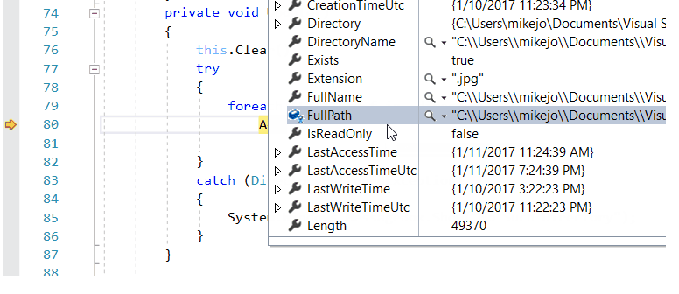

Slide 18
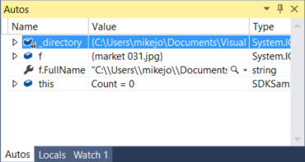
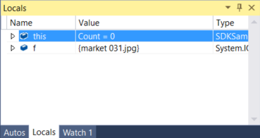
Inspect variables with the Autos and Locals windows
While debugging, look at the Autos window at the bottom of the code editor.
In the Autos window, you see variables along with their current value and their type. The Autos window shows all variables used on the current line or the preceding line.
Next, look at the Locals window. The Locals window shows you the variables that are currently in scope.

Slide 19
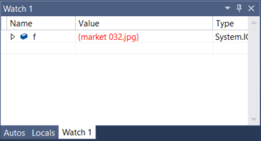
Set a watch
You can use a Watch window to specify a variable (or an expression) that you want to keep an eye on.
While debugging, right-click an object and choose Add Watch.
In this example, you have a watch set on the f object, and you can see its value change as you move through the debugger. Unlike the other variable windows, the Watch windows always show the variables that you are watching (they're greyed out when out of scope).

Slide 20
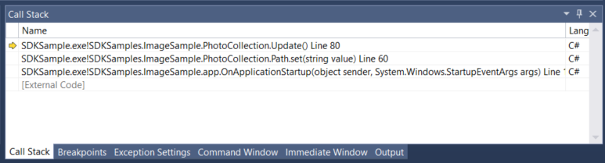
Examine the call stack
Click the Call Stack window while you are debugging, which is by default open in the lower right pane.
The Call Stack window shows the order in which methods and functions are getting called. The top line shows the current function (the Update method in this example). The second line shows that Update was called from the Path.set property, and so on. The call stack is a good way to examine and understand the execution flow of an app.
Note
The Call Stack window is similar to the Debug perspective in some IDEs like Eclipse.

Slide 21
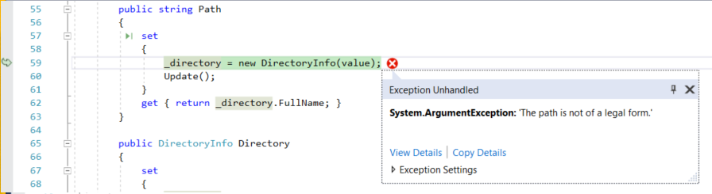
Examine an exception
When your app throws an exception, the debugger takes you to the line of code that threw the exception.

Slide 22
In this example, the Exception Helper shows you a System.Argument exception and an error message that says that the path is not a legal form. So, we know the error occurred on a method or function argument.
In this example, the DirectoryInfo call gave the error on the empty string stored in the value variable.
The Exception Helper is a great feature that can help you debug errors. You can also do things like view error details and add a watch from the Exception Helper. Or, if needed, you can change conditions for throwing the particular exception.

Slide 23
https://docs.microsoft.com/en-us/visualstudio/get-started/csharp/tutorial-debugger?toc=/visualstudio/debugger/toc.json&view=vs-2017

Slide 24
Learn to debug c#

Slide 25
Create a project
In Visual Studio, choose File > New Project.
Under Visual C#, choose Windows Desktop, and then in the middle pane choose Console App.
If you don't see the Console Application project template, click the Open Visual Studio Installer link in the left pane of the New Project dialog box. The Visual Studio Installer launches. Choose the .NET desktop development* workload, then choose Modify.
Type a name like get-started-debugging and click OK.
Visual Studio creates the project.

Slide 26
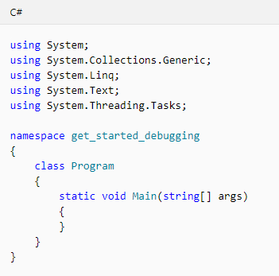
Create a project
In Program.cs, replace the following code
With this code showm in the next slide
Notes:
using System;
using System.Collections.Generic;
public class Shape
{
// A few example members
public int X { get; private set; }
public int Y { get; private set; }
public int Height { get; set; }
public int Width { get; set; }
// Virtual method
public virtual void Draw()
{
Console.WriteLine("Performing base class drawing tasks");
}
}
class Circle : Shape
{
public override void Draw()
{
// Code to draw a circle...
Console.WriteLine("Drawing a circle");
base.Draw();
}
}
class Rectangle : Shape
{
public override void Draw()
{
// Code to draw a rectangle...
Console.WriteLine("Drawing a rectangle");
base.Draw();
}
}
class Triangle : Shape
{
public override void Draw()
{
// Code to draw a triangle...
Console.WriteLine("Drawing a trangle");
base.Draw();
}
}
class Program
{
static void Main(string[] args)
{
var shapes = new List<Shape>
{
new Rectangle(),
new Triangle(),
new Circle()
};
foreach (var shape in shapes)
{
shape.Draw();
}
// Keep the console open in debug mode.
Console.WriteLine("Press any key to exit.");
Console.ReadKey();
}
}
/* Output:
Drawing a rectangle
Performing base class drawing tasks
Drawing a triangle
Performing base class drawing tasks
Drawing a circle
Performing base class drawing tasks
*/

Slide 27
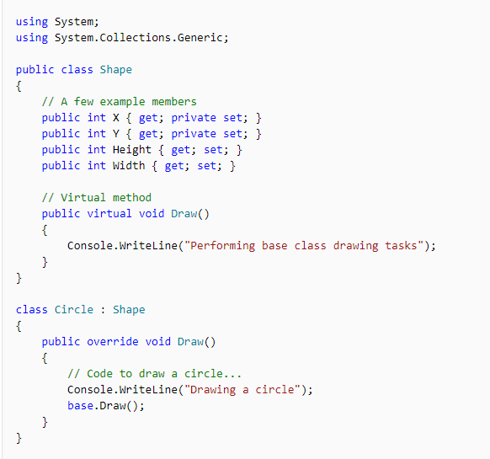
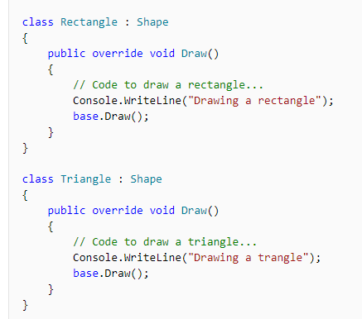

Slide 28
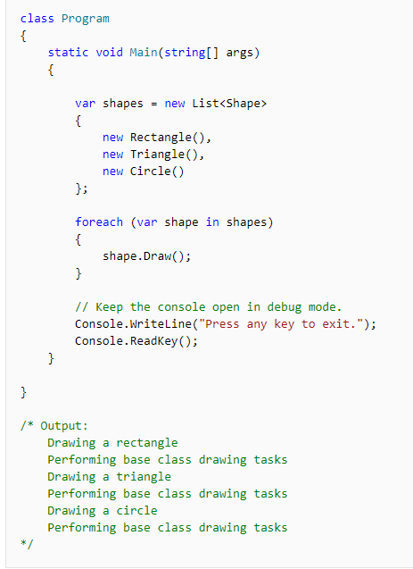

Slide 29
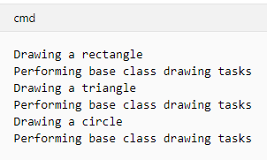
Start the debugger!
Press F5 (Debug > Start Debugging) or the Start Debugging button Start Debugging in the Debug Toolbar.
F5 starts the app with the debugger attached to the app process, but right now we haven't done anything special to examine the code. So the app just loads and you see the console output.
Stop the debugger by pressing the red stop Debugging button.

Slide 30
Set a breakpoint and start the debugger
In the foreach loop of the Main function, set a breakpoint by clicking the left margin of the following line of code:
shape.Draw()
A red circle appears where you set the breakpoint.
Breakpoints are the most basic and essential feature of reliable debugging. A breakpoint indicates where Visual Studio should suspend your running code so you can take a look at the values of variables, or the behavior of memory, or whether or not a branch of code is getting run.
Press F5 or the Start Debugging button Start Debugging, the app starts, and the debugger runs to the line of code where you set the breakpoint.

Slide 32
Navigate code in the debugger using step commands
Mostly, we use the keyboard shortcuts here, because it's a good way to get fast at executing your app in the debugger (equivalent commands such as menu commands are shown in parentheses).
F11 is the Step Into command and advances the app execution one statement at a time. F11 is a good way to examine the execution flow in the most detail.
Notice this time that the debugger does not step into the Draw method of the base class (Shape). F10 advances the debugger without stepping into functions or methods in your app code (the code still executes). By pressing F10 on the base.Draw method call (instead of F11), we skipped over the implementation code for base.Draw

Slide 33
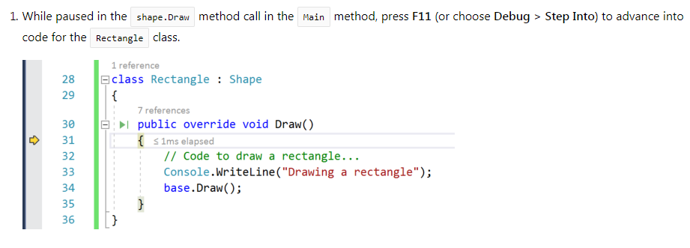
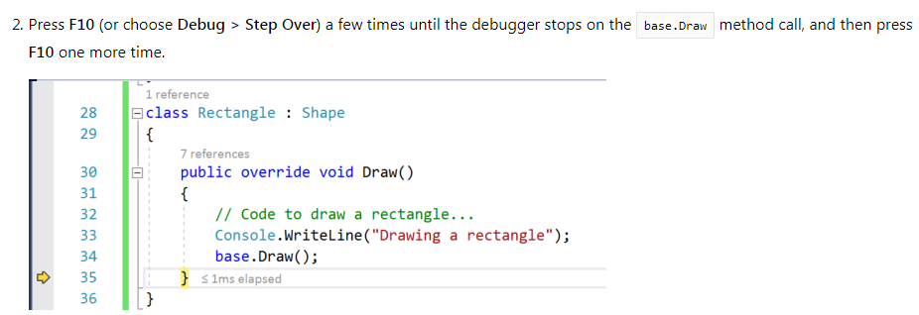

Slide 34
Navigate code using Run to Click
Using this button is similar to setting a temporary breakpoint. Run to Click is handy for getting around quickly within a visible region of app code (you can click in any open file).
The debugger advances to the Console.WriteLine method implementation for the Triangle class.
While paused, you notice a typo! The output "Drawing a trangle" is misspelled. We can fix it right here while running the app in the debugger.

Slide 35
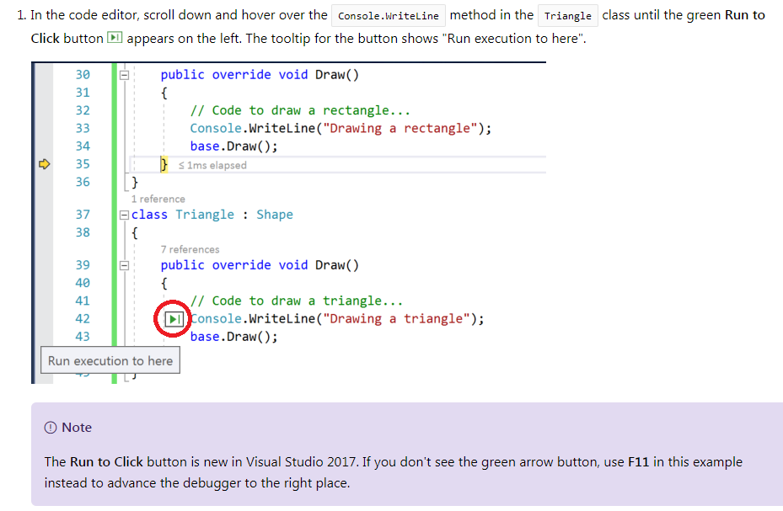

Slide 36
Edit code and continue debugging
Click into "Drawing a trangle" and type a correction, changing "trangle" to "triangle".
Press F11 once and you see that the debugger advances again.

Slide 37
Step out
Let's say that you are done examining the Draw method in the Triangle class, and you want to get out of the function but stay in the debugger. You can do this using the Step Out command.
Press Shift + F11 (or Debug > Step Out).
This command resumes app execution (and advances the debugger) until the current function returns.
You should be back in the foreach loop in the Main method.

Slide 38
Restart your app quickly
Click the Restart Restart App button in the Debug Toolbar (Ctrl + Shift + F5).
When you press Restart, it saves time versus stopping the app and restarting the debugger. The debugger pauses at the first breakpoint that is hit by executing code.
The debugger stops again at the breakpoint you set, on the shape.Draw() method.

Slide 39
Inspect variables with data tips
Features that allow you to inspect variables are one of the most useful features of the debugger, and there are different ways to do it. Often, when you try to debug an issue, you are attempting to find out whether variables are storing the values that you expect them to have at a particular time.
While paused on the shape.Draw() method, hover over the shape object and you see its default property value, which is the object type Rectangle.
Expand the shape object to see its properties, such as the Height property, which has a value of 0.
Press F10 (or Debug > Step Over) a few times to iterate once through the foreach loop, pausing again on shape.Draw().
Hover over the shape object again, and this time you see that you have a new object with a type Triangle.

Slide 40
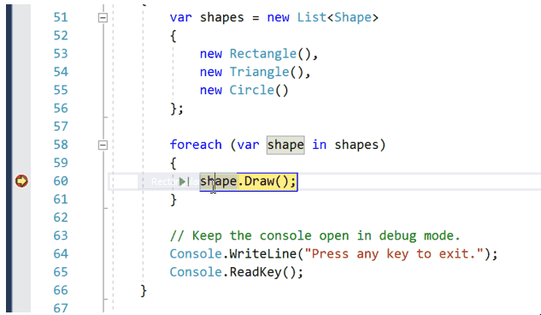
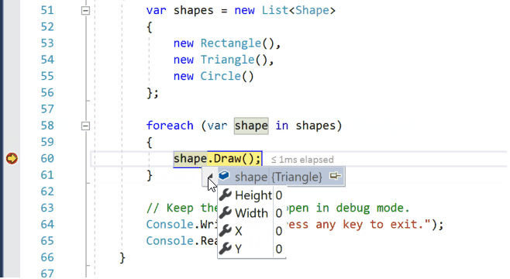

Slide 41
Inspect variables with the Autos and Locals windows
Look at the Autos window at the bottom of the code editor.
If it is closed, open it while paused in the debugger by choosing Debug > Windows > Autos.
Expand the shapes object.
In the Autos window, you see variables and their current value. The Autos window shows all variables used on the current line or the preceding line (Check documentation for language-specific behavior).
Next, look at the Locals window, in a tab next to the Autos window.
The Locals window shows you the variables that are in the current scope, that is, the current execution context

Slide 42
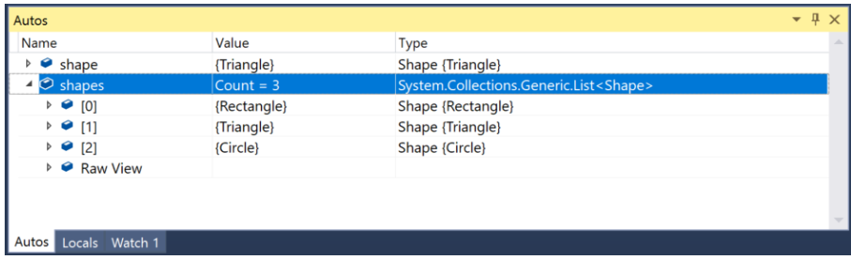

Slide 43
Set a watch
In the main code editor window, right-click the shapes object and choose Add Watch.
The Watch window opens at the bottom of the code editor. You can use a Watch window to specify a variable (or an expression) that you want to keep an eye on.
Now, you have a watch set on the shapes object, and you can see its value change as you move through the debugger. Unlike the other variable windows, the Watch window always shows the variables that you are watching (they're grayed out when out of scope).

Slide 44
Examine the call stack
While paused in the foreach loop, click the Call Stack window, which is by default open in the lower right pane.
If it is closed, open it while paused in the debugger by choosing Debug > Windows > Call Stack.
Click F11 a few times until you see the debugger pause in the Base.Draw method for the Triangle class in the code editor. Look at the Call Stack window.

Slide 45
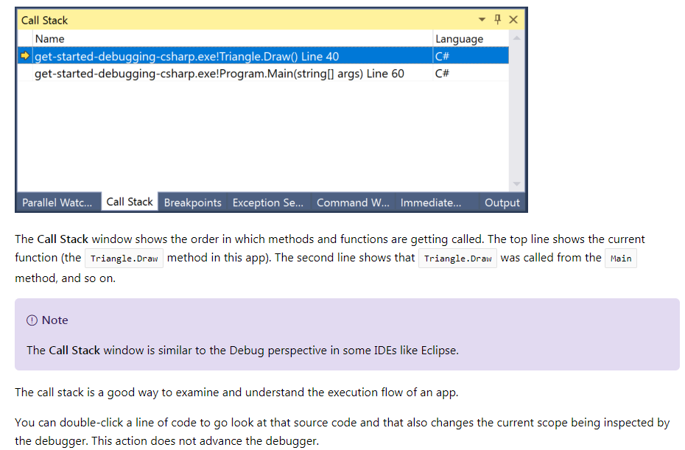

Slide 46
Change the execution flow
With the debugger paused in the Circle.Draw method call, use the mouse to grab the yellow arrow (the execution pointer) on the left and move the yellow arrow up one line to the Console.WriteLine method call.
Press F11.
The debugger reruns the Console.WriteLine method (you see this in the console window output).
By changing the execution flow, you can do things like test different code execution paths or rerun code without restarting the debugger.
Warning
Often you need to be careful with this feature, and you see a warning in the tooltip. You may see other warnings, too. Moving the pointer cannot revert your application to an earlier app state.
Press F5 to continue running the app.

